Slide 1


Predicting COVID-19 Cases Using Deep Neural Networks Based on Trends and Impact Survey Data
Dania Zein
Oct. 14, 2023
Tougaloo College

Slide 2
Overview
Background on COVID-19 Survey
Significance of Predicting COVID-19 with DNNs
Aim of the Project
Deep Neural Networks (DNN)
What is DNN
How do DNN learn?
Optimization of DNN Model
Data Preprocessing
Model Architecture & Training
Results & Findings
Conclusion & Future Work

Slide 3
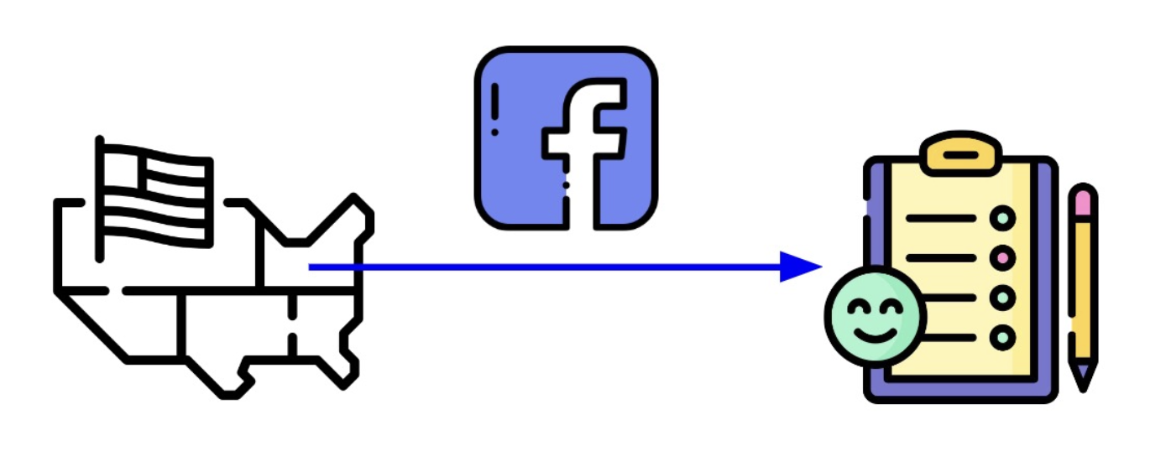
COVID-19 Trends and Impact Survey (CTIS)
Background
The Delphi Research Group at Carnegie Mellon University conducted a continuous survey from April 2020 to June 2022 to monitor the spread and impact of the COVID-19 pandemic in the United States of America
CTIS consisted of 40,000 daily participants in the United States of America
Survey respondents were asked about their symptoms, COVID-19 testing, prior medical conditions, social distancing measures, mental health, demographics, and the economic effects of the pandemic, totaling to 18 questions per day

Slide 4
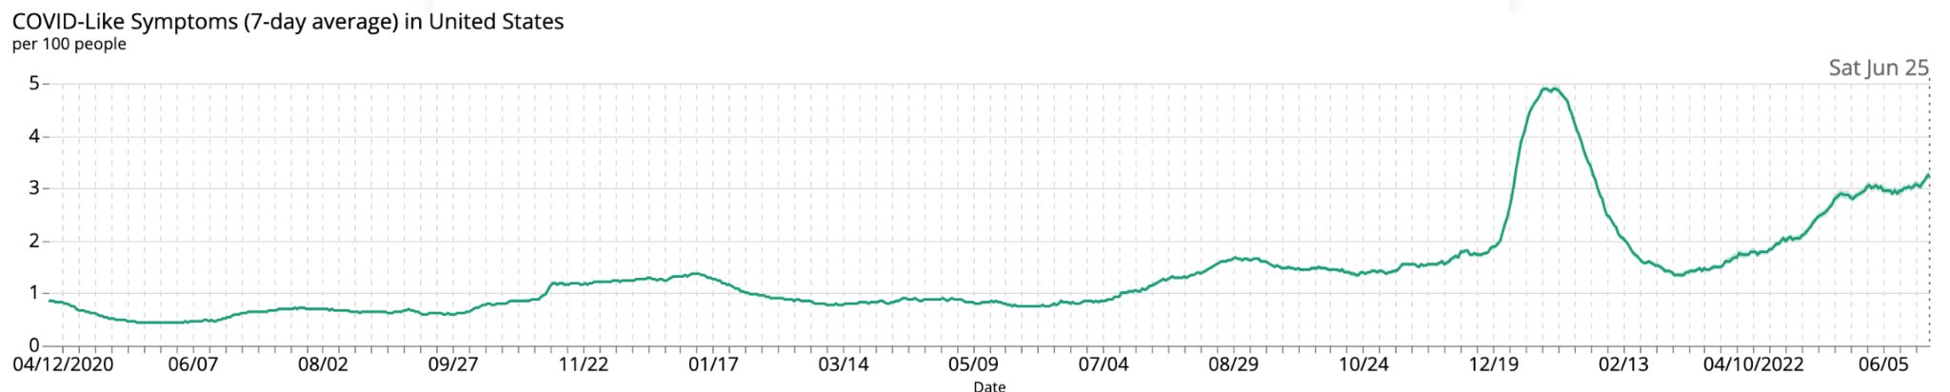
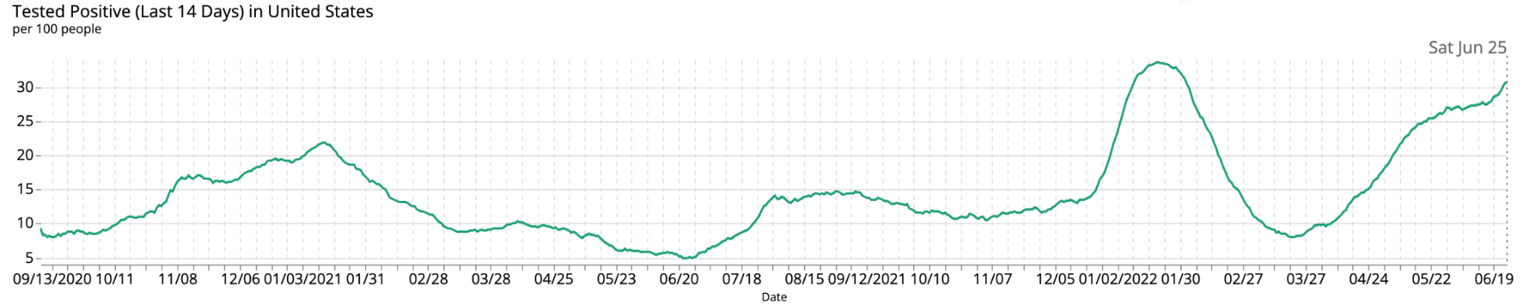
Background
In the past 24 hours, have you or anyone in your household experienced a fever, along with cough, shortness of breath, or difficulty breathing?
If you were tested for COVID-19 in the past 14 days, was the test positive?

Slide 5
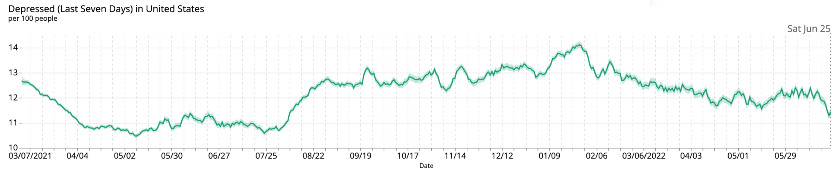
Background
In the past 7 days, did you feel depressed most or all of the time?
If you were tested for COVID-19 in the past 14 days, was the test positive?

Slide 6
Significance of Predicting COVID-19 with DNNs
Objective
Accurate predictions can guide governments and health organizations in making informed decisions on interventions, resource allocations, and public advisories.
Leveraging trends and impact survey data provides a unique approach, potentially uncovering patterns missed by traditional epidemiological data.
DNNs have the capacity to capture intricate patterns in vast datasets, potentially enhancing prediction accuracy.

Slide 7
Aim of the Project
Objective
To develop and evaluate a Deep Neural Network (DNN) model that leverages Trends and Impact Survey Data to provide accurate predictions of COVID-19 cases.
Model Evaluation: Compare the DNN model's predictions to actual reported case numbers.
Informative Insights: Extract valuable patterns that can guide future public health decisions.

Slide 8
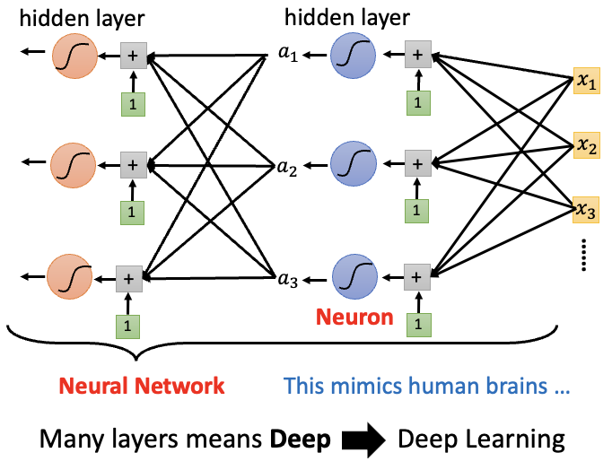
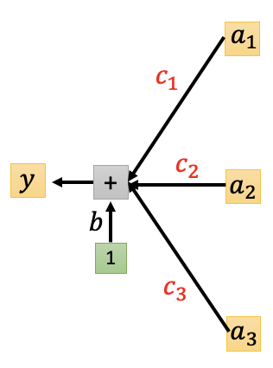



What are Deep Neural Networks (DNNs)?
Method
DNNs are a subtype of AI networks with multiple layers between the input and output layers
Each layer comprises neurons that process data, transfer information, and help the network "learn" from data.
Their "depth" allows DNNs to extract intricate, non-linear features from large datasets.
Input layer
$$w_{11}$$
$$w_{12}$$
output layer
$$w_{13}$$

Slide 9
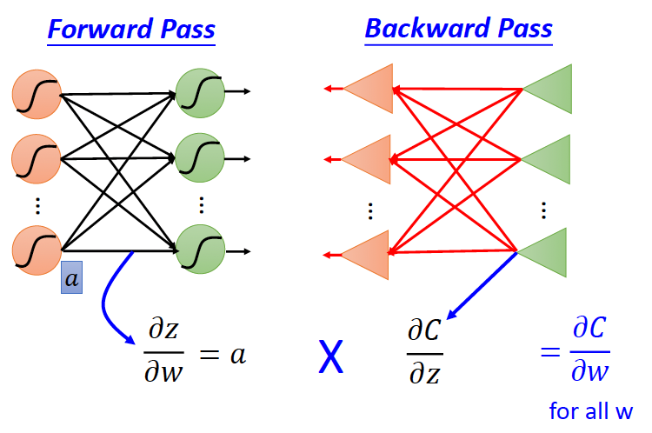
How Do DNNs Learn?
Method
Initialization: Weights are randomly set for all neurons.
Forward Propagation: Data is passed through the network, and a prediction is made.
Backpropagation: Errors between the prediction and the actual value are calculated and propagated backward to adjust weights.
Iteration: The above steps are repeated, refining weights to reduce errors.

Slide 10
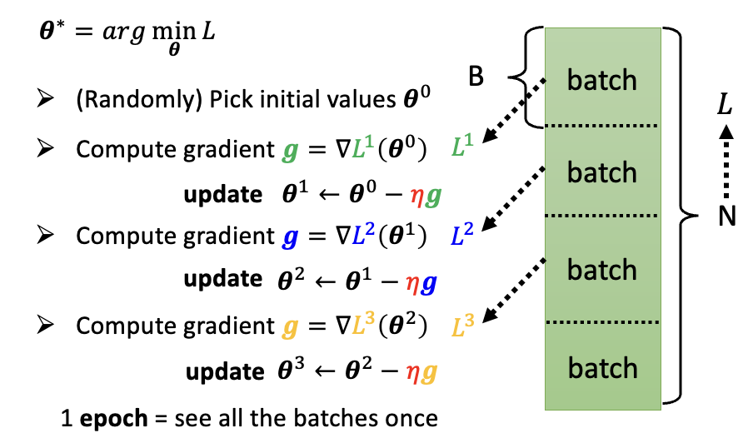
How Do DNNs Learn?
Method
Initialization: Weights are randomly set for all neurons.
Forward Propagation: Data is passed through the network, and a prediction is made.
Backpropagation: Errors between the prediction and the actual value are calculated and propagated backward to adjust weights.
Iteration: The above steps are repeated, refining weights to reduce errors.

Slide 11
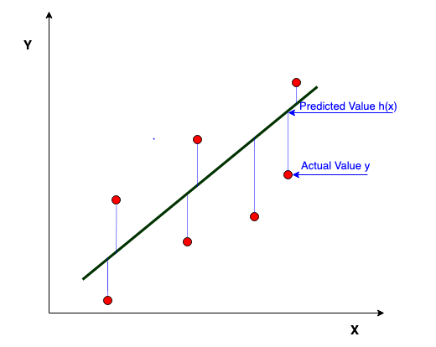
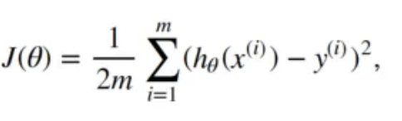

How Do DNNs Learn?
Method
Initialization: Weights are randomly set for all neurons.
Forward Propagation: Data is passed through the network, and a prediction is made.
Backpropagation: Errors between the prediction and the actual value are calculated and propagated backward to adjust weights.
Iteration: The above steps are repeated, refining weights to reduce errors.

Slide 12
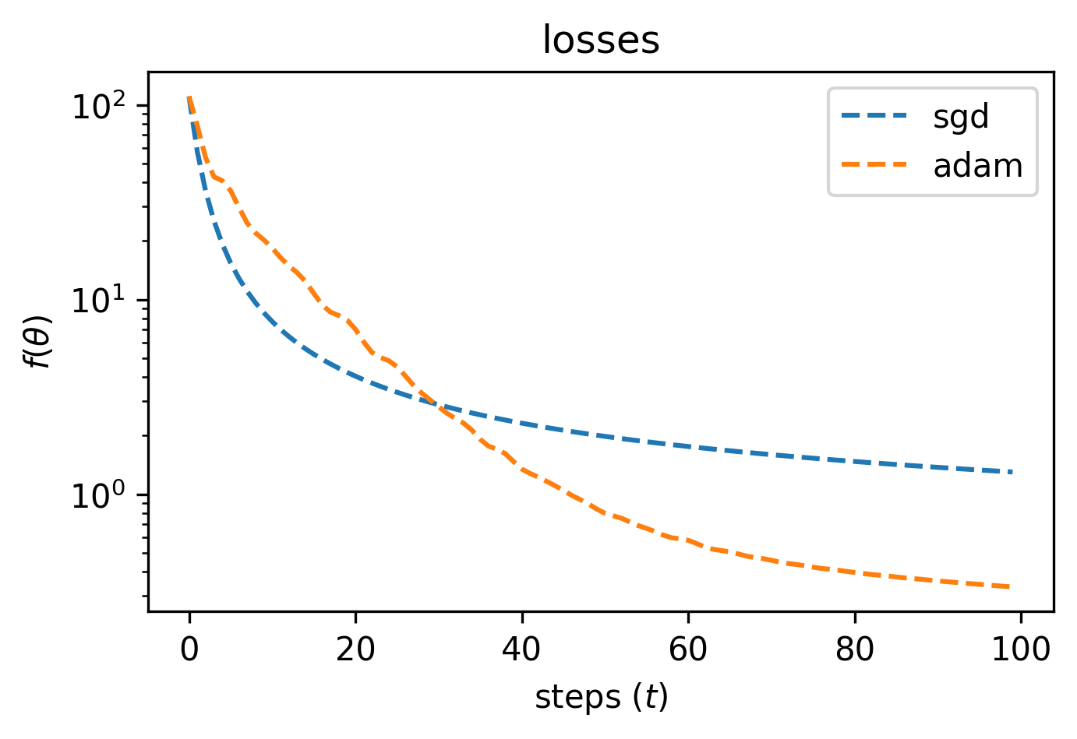
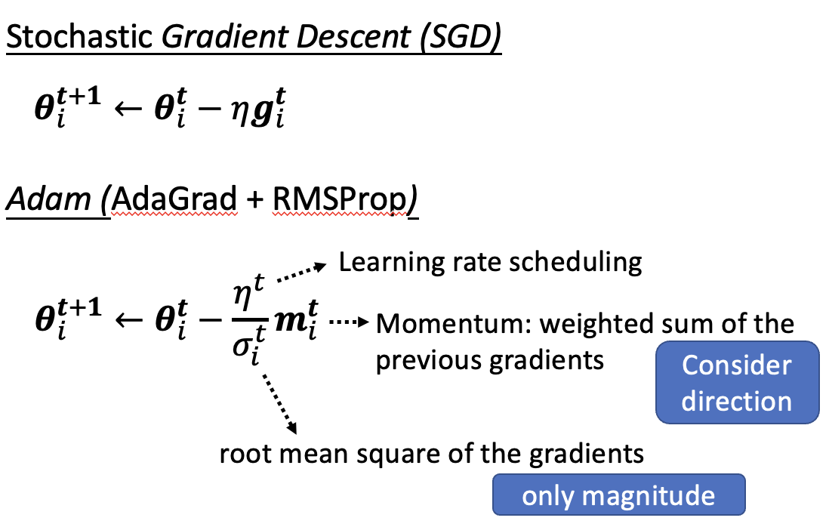
Optimizers: SGD vs. Adam
Method
While both SGD and Adam can be effective, Adam often outperforms SGD in deep learning tasks due to its adaptive learning rate and faster convergence.

Slide 13
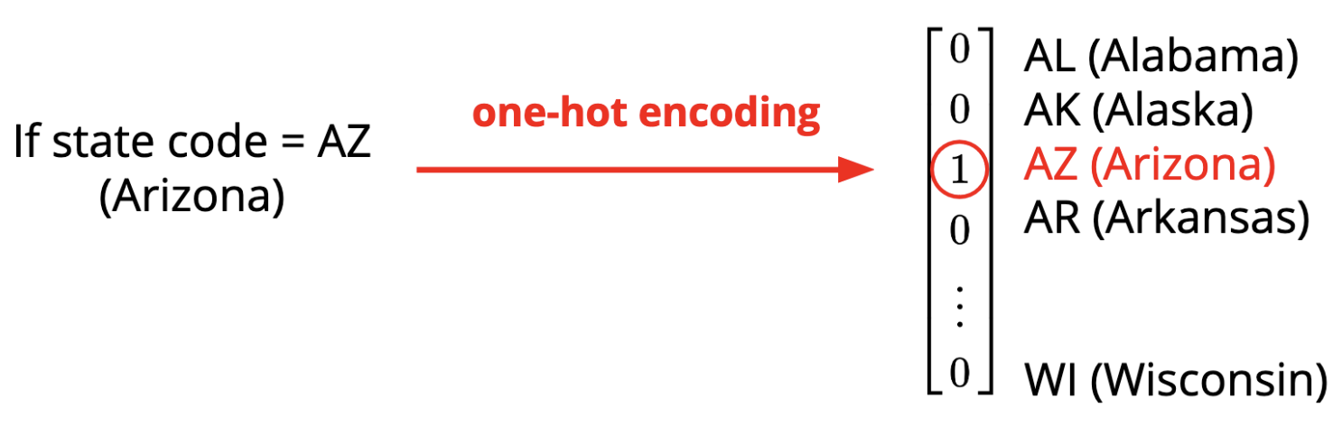
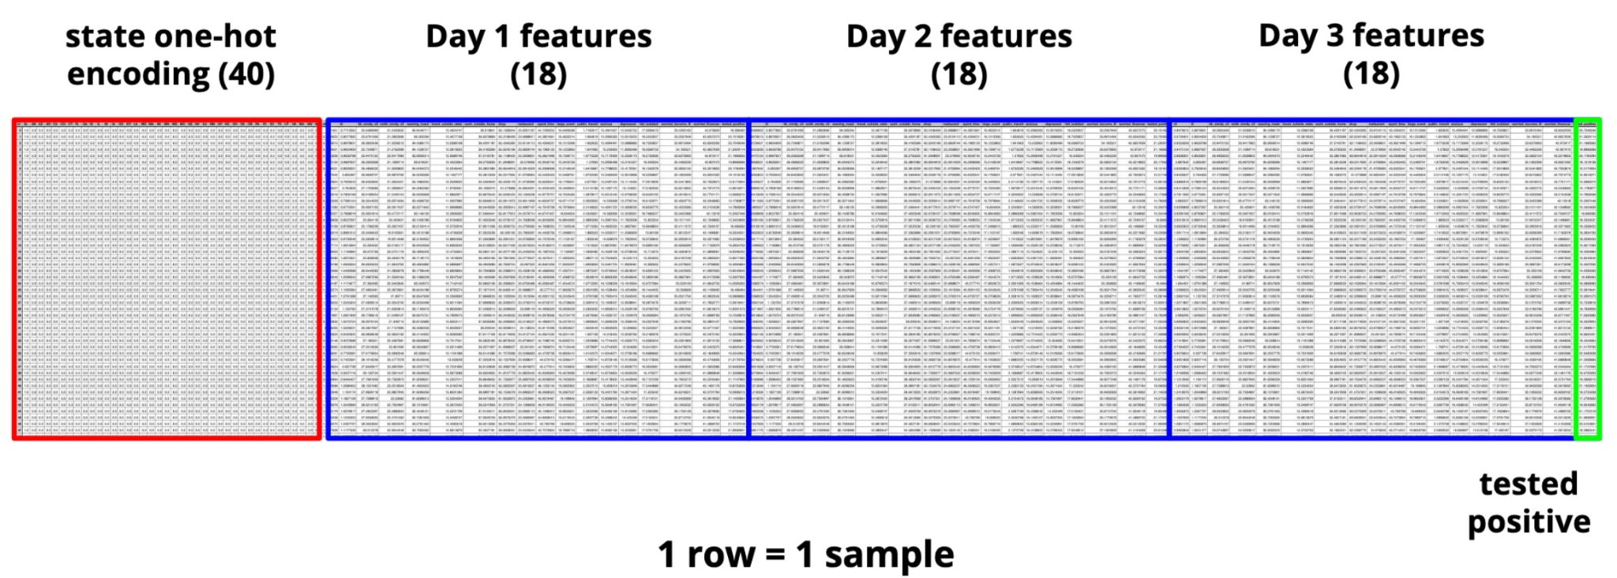
Data Preprocessing
Method
One-hot vector encoding States
Given a three-day data span from the CTIS, to predict the number of positive COVID-19 cases in specific U.S. states in the third day
Training samples: 2700
Training features: 94
Testing samples: 893

Slide 14

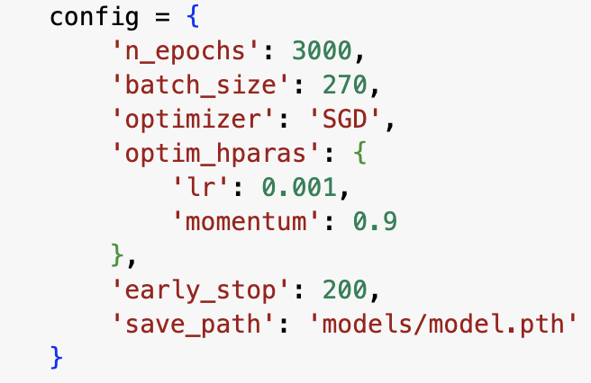

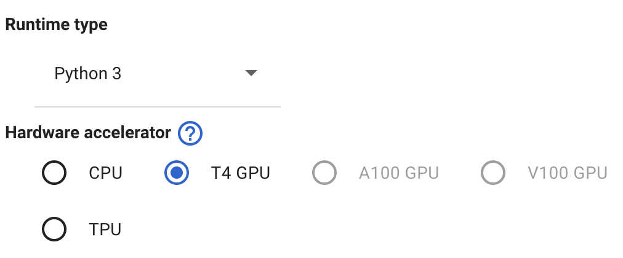

Model Architecture & Training
Method
Hyperparameters
Notes:
Google Colab: A free cloud service by Google.
GPU Advantage: Accelerated training times and improved performance.
Accessibility: Allows for training complex models without needing high-end local machines.
Benefit: Enables us to train deeper and more complex DNN architectures efficiently.
PyTorch: A powerful deep learning framework, Enables building dynamic neural network architectures.

Slide 15
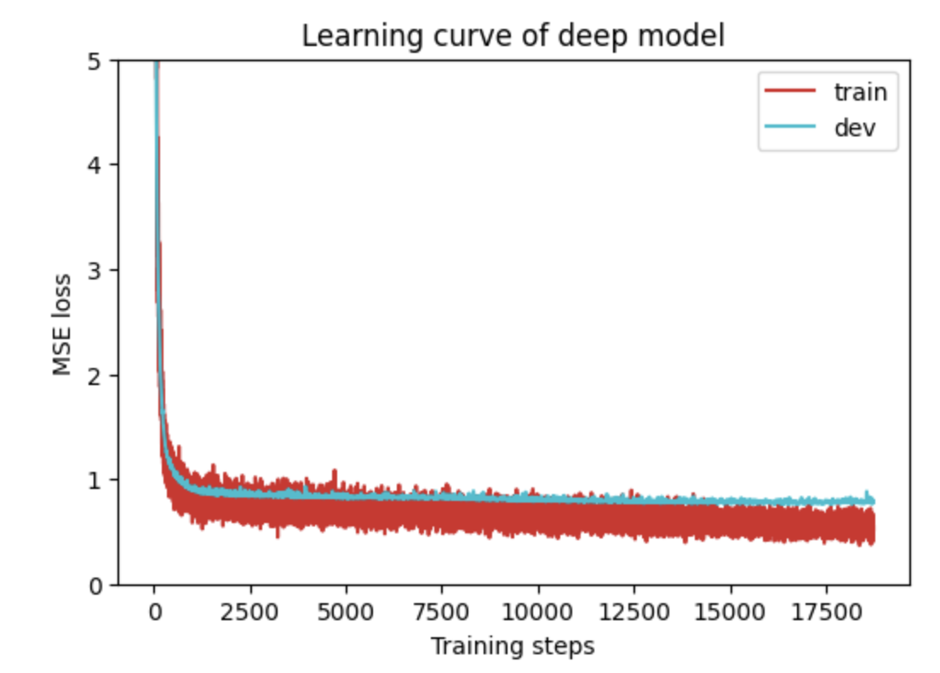
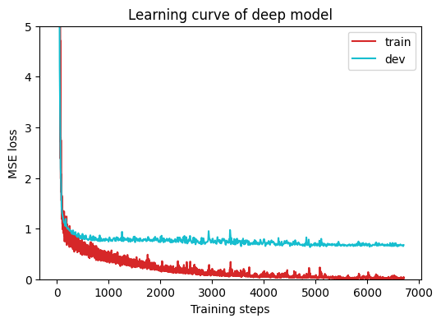
Loss Function Plot Analysis
Results
Training Loss: Indicates how well our model is fitting to the training data.
Validation Loss: Gives insight into the model's performance on unseen data.
Overfitting : Occurs when our model has memorized training data but does not generalize well to new data while testing.
Early Stop Strategy: 200 steps

Slide 16
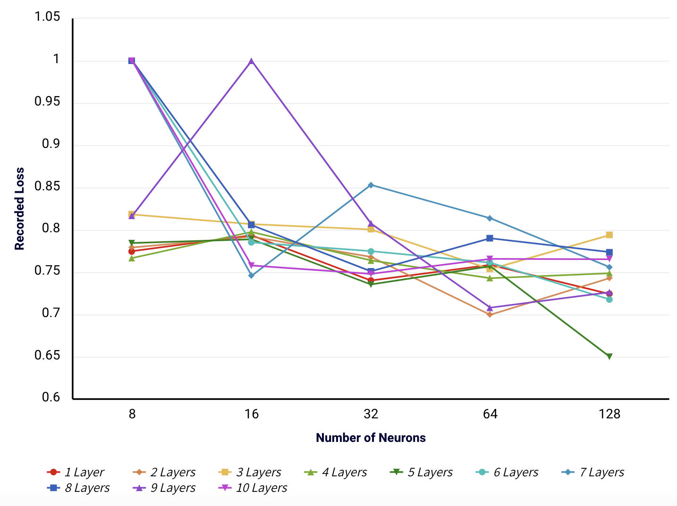
Adjusting the Number of Layers to Minimize Loss
Results
Lowest Recorded Loss after 10 layers:
1 Hidden Layer with 128 neurons = 0.7242
6 Hidden Layers with 128 neurons = 0.7178
9 Hidden Layers with 64 neurons = 0.7081
2 Hidden Layers with 64 neurons = 0.6996
5 Hidden Layers with 128 neurons = 0.6502

Slide 17
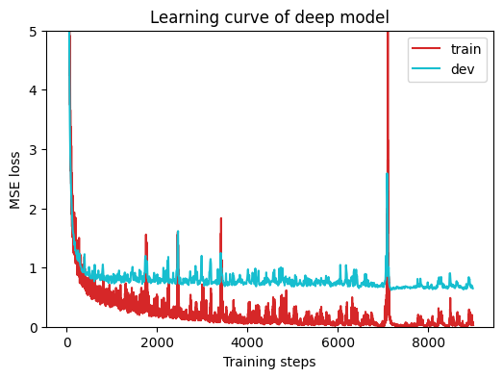
Models Performance with different Optimizer
Results
Changing the type of Optimizer
Overfit
Recorded Loss | SGD | ADAM
1 Hidden Layer with 128 neurons | 0.7242 | 0.7480
2 Hidden Layers with 64 neurons | 0.6996 | 0.7640
5 Hidden Layers with 128 neurons | 0.6502 | 0.7378
6 Hidden Layers with 128 neurons | 0.7178 | 0.7064
9 Hidden Layers with 64 neurons | 0.7081 | 0.7658

Slide 18
Measuring the Model’s Performance
Results
Fixed Neurons (128)
Adjusting the Layers
Fixed Layers (5)
Adjusting the Neurons
Testing our Model
Layers | Recorded Loss
1 | 0.7595
2 | 0.7430
3 | 0.7939
4 | 0.7487
5 | 0.6502
6 | 0.7178
7 | 0.7561
8 | 0.7738
9 | 0.7263
10 | 0.7653
Neurons | Recorded Loss
64 | 0.7570
128 | 0.6502
256 | 0.6821
512 | 0.7581
1024 | 0.6414 (overfit)
Neurons | Recorded Loss
Input, 128, 128, 128, 128, 128, 1 | 0.6502
Input, 128, 256, 512, 128, 64, 1 | 0.7065
Input, 128, 256, 512, 256, 128, 1 | 0.7596
Input, 128, 256, 512, 1024, 2048, 1 | 0.7377
Input, 128, 512, 2048, 512, 128, 1 | 0.6710 (overfit)
Input, 128, 1024, 2048, 1024, 128, 1 | 0.7148

Slide 19
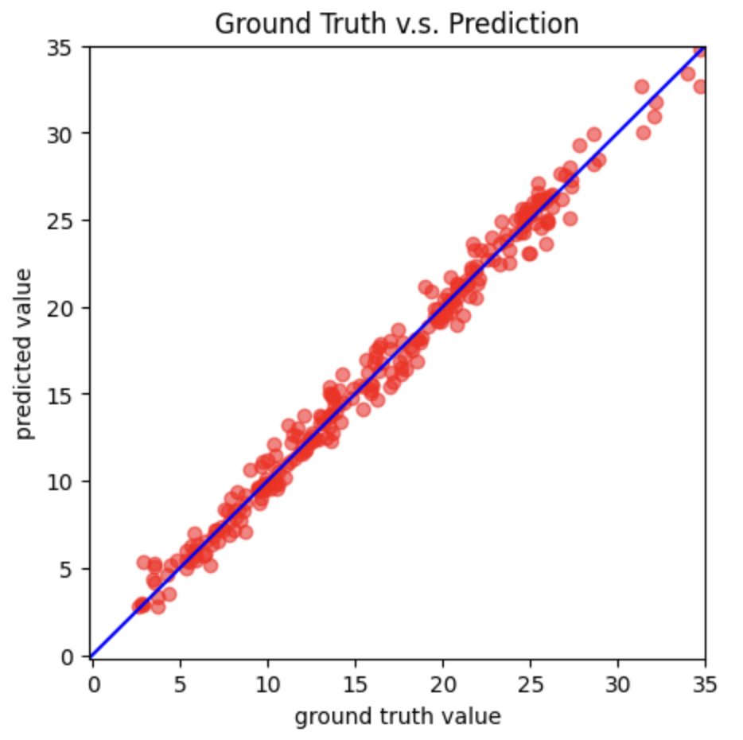
Model Fitting to Data
Results
X-axis labeled as "Ground Truth Data.”
Y-axis labeled as "Predicted Data.”
Data points on the scatter plot showing the relationship between the actual values and predicted values.
Points close to the 45-degree line indicate accurate predictions.
Any systematic deviation from the 45-degree line may suggest a bias in the model predictions.

Slide 20
Future Works
Conclusion
Incorporate additional relevant survey metrics and more diverse respondent data to refine and enhance predictions.
Explore recurrent neural networks (RNNs) or Long Short-Term Memory (LSTM) networks given the temporal nature of the data.

Slide 21
Acknowledgment
Conclusion
Mentorship: Thanks to Dr. Xiuquan Wang for his invaluable guidance, expertise, and unwavering support throughout this project.
Funding: This research was generously supported by the NSF HBCU UP RIA grant. We extend our deepest gratitude for their investment and belief in our work.

Slide 22
References
Conclusion
IBM. “What Is Machine Learning?” Www.ibm.com,IBM,www.ibm.com/topics/machine-learning.
https://aws.amazon.com/what-is/deep-learning/“What Is Deep Learning? Deep Learning Explained - AWS.” Amazon Web Services, Inc., aws.amazon.com/what-is/deep-learning/.
Wikipedia Contributors. “Deep Learning.” Wikipedia, Wikimedia Foundation, 10 May 2019, en.wikipedia.org/wiki/Deep_learning.
“Neural Networks: Structure | Machine Learning Crash Course.” Google Developers, developers.google.com/machine-learning/crash-course/introduction-to-neural-networks/anatomy.
“L1/L2 Regularization in PyTorch.” Stack Overflow, stackoverflow.com/questions/42704283/l1-l2-regularization-in-pytorch.
“Torch.optim — PyTorch 1.8.1 Documentation.” Pytorch.org, pytorch.org/docs/stable/optim.html.
“L1L2 Regularization in PyTorch a Comprehensive Guide for Data Scientists | Saturn Cloud Blog.” Saturncloud.io, 7 June 2023, saturncloud.io/blog/l1l2-regularization-in-pytorch-a-comprehensive-guide-for-data-scientists/#:~:text=To%20implement%20L2%20regularization%20in.
Radhakrishnan, Pranoy. “What Are Hyperparameters ? And How to Tune the Hyperparameters in a Deep Neural Network?” Medium, 18 Oct. 2017, towardsdatascience.com/what-are-hyperparameters-and-how-to-tune-the-hyperparameters-in-a-deep-neural-network-d0604917584a.
“Torch.optim — PyTorch 1.8.1 Documentation.” Pytorch.org, pytorch.org/docs/stable/optim.html.
“What Is Adam? What’s the Main Difference between Adam and SGD?” CodeAhoy, codeahoy.com/questions/ds-interview/33/#:~:text=Adam%20tends%20to%20converge%20faster.
“PyTorch Loss Functions: The Ultimate Guide.” Neptune.ai, 16 Oct. 2020, neptune.ai/blog/pytorch-loss-functions.
“Activation Functions in Pytorch.” GeeksforGeeks, 19 Apr. 2022, www.geeksforgeeks.org/activation-functions-in-pytorch/.
“Intuition of Adam Optimizer.” GeeksforGeeks, 22 Oct. 2020, www.geeksforgeeks.org/intuition-of-adam-optimizer/.
“Torch.nn — PyTorch Master Documentation.” Pytorch.org, pytorch.org/docs/stable/nn.html.
‌Seif, George. “Understanding the 3 Most Common Loss Functions for Machine Learning Regression.” Medium, 3 Oct. 2021, towardsdatascience.com/understanding-the-3-most-common-loss-functions-for-machine-learning-regression-23e0ef3e14d3.
“Mean Squared Error (MSE) — PyTorch-Metrics 1.1.0 Documentation.” Torchmetrics.readthedocs.io, torchmetrics.readthedocs.io/en/stable/regression/mean_squared_error.html.
“MSELoss — PyTorch 1.7.0 Documentation.” Pytorch.org, pytorch.org/docs/stable/generated/torch.nn.MSELoss.html.
“L1L2 Regularization in PyTorch a Comprehensive Guide for Data Scientists | Saturn Cloud Blog.” Saturncloud.io, 7 June 2023, saturncloud.io/blog/l1l2-regularization-in-pytorch-a-comprehensive-guide-for-data-scientists/.
https://medium.com/analytics-vidhya/how-to-add-additional-layers-in-a-pre-trained-model-using-pytorch-5627002c75a5
‌“Linear — PyTorch 1.8.0 Documentation.” Pytorch.org, pytorch.org/docs/stable/generated/torch.nn.Linear.html.
‌“Activation Function: Basics | Kaggle.” Www.kaggle.com, www.kaggle.com/discussions/general/187778.
SHARMA, SAGAR. “Activation Functions in Neural Networks.” Medium, Towards Data Science, 6 Sept. 2017, towardsdatascience.com/activation-functions-neural-networks-1cbd9f8d91d6.
“What Is a Neural Network?” TIBCO Software, www.tibco.com/reference-center/what-is-a-neural-network.

Slide 23

Any Questions?
Conclusion

